Slide 1
Il gestore aeroportuale tra economia
di scalo e sviluppo del territorio
Daniela Baglieri
Presidente SAC SpA

Slide 2
STARTING POINT…
ITALIAN LIBERALIZATION =>AIR TRANSPORT SYSTEM GROWTH
TRAFFIC GROWTH => CAPACITY CRUNCH
CAPACITY CRUNCH=> INTEGRATION, INTERMODALITY, INVESTMENT
WHICH IS THE ROLE OF AIRPORTS IN THIS CONTEXT?

Slide 3
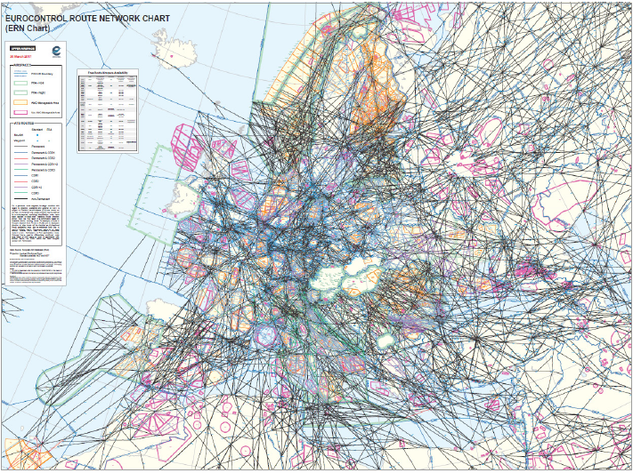
Europe's Regional Airports
Network of 500 airports
Providing 14,600 routes
With 209 air carriers
Across 724 destinations
Supporting €85 billion of Europe’s GDP
Source: ACI Regional Airports Forum publication 2017: Europe’s Regional Airports; Connecting People, Places and Products

Slide 4
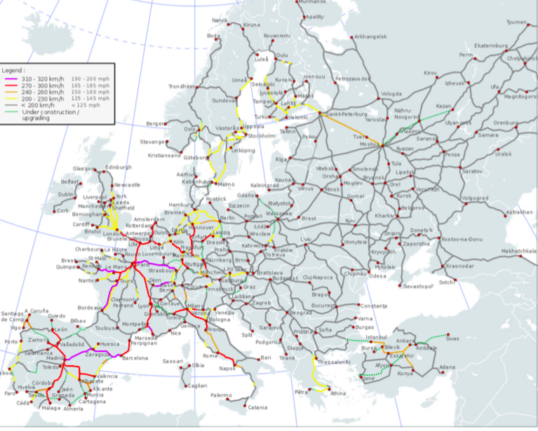
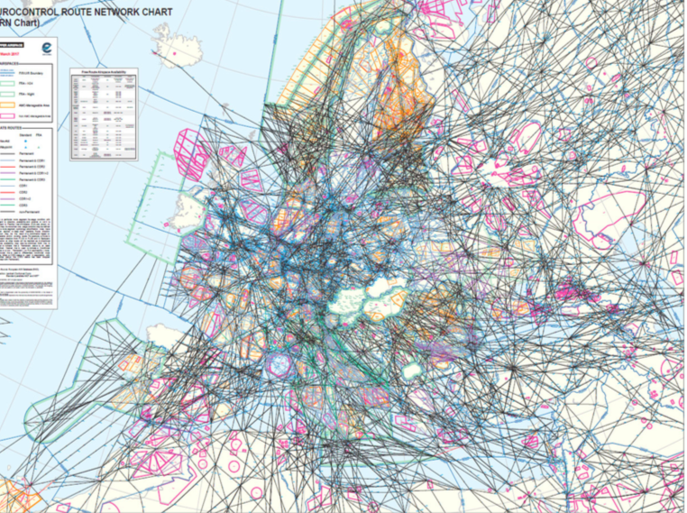
EUROPEAN HIGH SPEED RAIL NETWORK - comparison
When combined together,regional airports provide a network that does much more than complementing the high-speed rail network.
European airports provide accessibility to the most remote areas of Europe

Slide 6
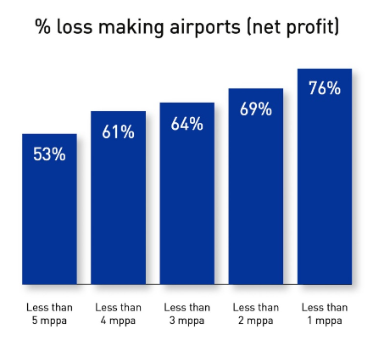
European Regional Airports financially challenging environment
The majority of airports in Europe with pax levels below 5m pax per annum are loss making
This percentage is broadly unchanged over 3 years
With low cost carriers moving up market and airlines focusing more on primary and larger markets, network development and revenue generation opportunities face significant challenges
Key policy challenge for the EU is the financial viability of the regional network of EU airports which is critical for business and tourism connectivity
Source: ACI Europe State of the Industry June 2017

Slide 7
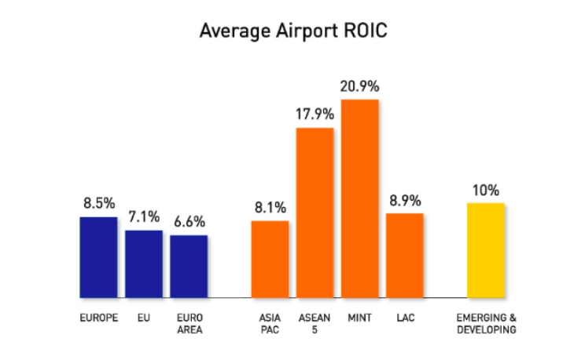

Slide 8
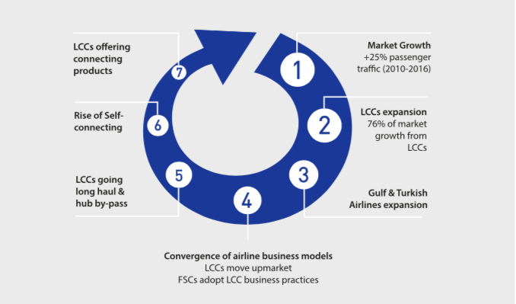
Market Drivers of airport competition 2000-2016

Slide 9
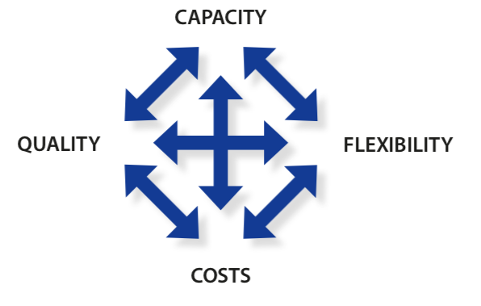
Airport management_ basic principles

Slide 10
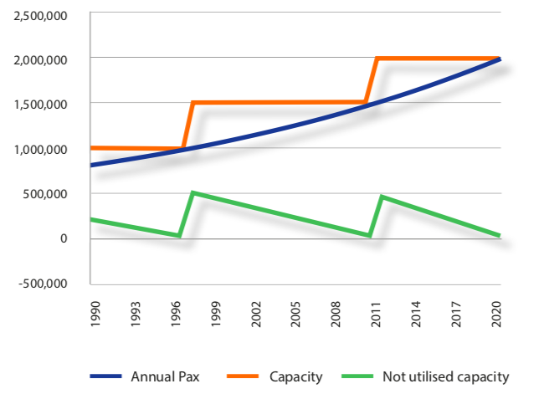
capacity
Capacity (and not traffic) is the main trigger of costs/expenses.
Regional airports are more exposed to volatility in their traffic development because they typically rely disproportionately on one kind of traffic or one airline and are less able to diversify their traffic mix compared to their larger counterparts.
Risk of over and underutilisation of capacity is very high

Slide 11
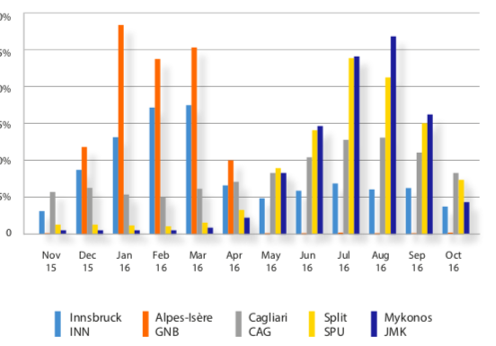
FLEXIBILITY
Regional airports are very exposed to peaks. Airport staff needs to be very flexible in terms of timing and area of expertise.
On the other hand, the work at a regional airport is not as complex as it can be at a hub airport, for example. Therefore, regional airports can employ “multi-functional” staff
Does regulatory framework allow it?
Airports with a stronger touristic focus serving as an incoming destination tend to show a high seasonality in traffic.
MONTHLY DISTRIBUTION OF
TRAFFIC AT SELECTED REGIONAL
AIRPORTS IN 2015-2016

Slide 12
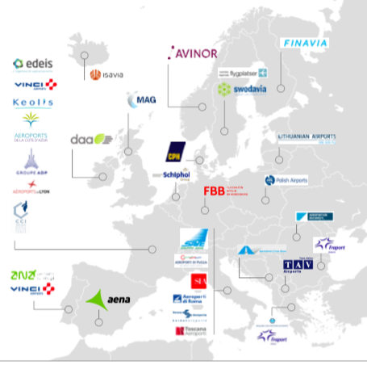
COSTS
The operating costs of airports also grow very quickly. Increasing and more stringent regulatory requirements for security, safety, environment, and border control
Network, groups and economies of scale (Directive 2009/12/CE on Airport Charges)
Recital 5. I
In order to promote territorial cohesion, Member States should have the possibility to apply a common charging system to cover an airport network. Economic transfers between airports in such networks should comply with Community law.
Article 2.5.
‘airport network’ means a group of airports duly designated as such by the Member State and operated by the same airport managing body.
Article 4. Airport network Member States may allow the airport managing body of an airport network to introduce a common and transparent airport charging system to cover the airport network.

Slide 13
quality
Aviation Security
Security procedures for airside areas
Regulation (EU) 2017/815 of 12 May 2017 amending Implementing Regulation (EU) 2015/1998 as regards clarification, harmonisation and
simplification of certain specific aviation security measure
PRM
Regulation (EU) 1107/2006 of the European Parliament and of the Council of 5 July 2006 concerning the rights of disabled persons and persons with reduced mobility when travelling by air
Aviation Safety (EASA) Regulation
Regulation (EC) 216/2008 of the European Parliament and of the Council of 20 February 2008 on common rules in the field of civil aviation and establishing a European Aviation Safety Agency, and repealing Council Directive 91/670/EEC, Regulation (EC) No 1592/2002 and Directive 2004/36/EC
Environmental Noise Directive (noise mapping and action planning)
Directive 2002/49/EC of the European Parliament and of the Council of 25 June 2002 relating to the assessment and management of environmental noise

Slide 14
Airport management_WRAP-UP
EXPLOITATION
BALANCE
DIVERSIFICATION
ECONOMIES, INNOVATION
AND INTEGRATION

Slide 16
THANKS FOR YOUR COMMENTS
Daniela Baglieri
d.baglieri@aeroporto.catania.it

